Slide 1
NLP Shared Task
TEAM-8
Ravi Ghadia - 17EC10045
Amrit Sahu - 17EC10066
Shubham Maheshwari - 17EC10055
Shivam Saxena - 17EC10054
Ritik Kumar - 17CS10044

Slide 2
Problem Statement
Lexical Complexity Prediction (LCP) of Single words and Multi Word Expressions (MWEs) on the Complex (MWEs) on the CompLex (Shardlow et al., 2020), a multi-domain English database annotated with a 5-point Likert scale of 1-5.

Slide 3
Introduction
01
Predicting word complexity is useful in many applications such as text simplification.
02
Important aspects that led to our solution of problem are :
Word as a single entity may vary in complexity, irrespective of content surrounding it.
Same tokens can have different definitions depending on the context.
03
Attempts to represent each word as a vector that contains both context and stand alone complexity factors and then process it using standard Neural Networks and Tree-based Regressor framework.

Slide 4
Approach
Used a dual-model based approach with motives:
Tree-Based Ensemble Regressor
Motive for this is that the complexity of the target word can be inferred by considering its structural information
Capture information about the token which is independent of its surrounding context
BERT-Based Ordinal Classifier
To capture the contextual information from the surrounding word of the target token
Took hidden states from the last 4 hidden layers of the Bert as the final embedding for the target token

Slide 5
Feature Vector for Regressor
Constructed Handmade feature vector for each target token taking into account several structural, syntactic as well statistical aspects of the target token.
Trained a Word2Vec model over the combined corpus
Concatenated hand-made features with the Word2Vec vector of the target token and fed to the regressor
Some of the hand-features used are word frequency, relative frequency, word length, lemmatized length, hypernym and hyponym similarity, number of hypernym and hyponym, average child synonyms.

Slide 6
Important Hand-Crafted Features
Relative Word Frequency : exp(-(ub_freq - word_freq)/(ub_freq - lb_freq)) where ub_freq,lb_freq denote the frequency of the least common and most common synonym of the word.
Lemmatized Word Length : To consider complexity added by Derivational morphology. For example govern and government have different meanings.
Hypernym and Hyponym similarity : to measure how specific or generic a word is.
Complexity of the Dependency parse tree : Count of synonyms of the parent and children of the target word was used.

Slide 7
Model Architecture
We have used a dual model approach to model both contextual and non-contextual information about the target token to predict it’s lexical complexity.
Ordinal Classifier has been used with the BERT-based model.
Ordinal Classification proved to be practically doing better than regression because it could predict very low complexity values as well due to its nature of prediction of a particular bin first along with a slight displacement from centre of the bin to give a real valued complexity score.
The nature of regression lets it to predict more of average values to minimise mse, so it could never predict scores below 0.2 and was predicting scores in a range of 0.2-0.5.
This flaw of regression can be understood from a thought experiment of trying to fit a straight line to samples derived from a step function.

Slide 8
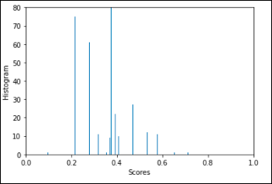
Ordinal Classification
In ordinal classification we decided to break the space of real line 0 to 1 into 10 bins representing 10 classes.
The complexity value range are as follows:
Class 0: [0,1/18), Class 1: [1/18,3/18) and so on until Class 9: [17/18,1).
Class vector representation:
Class 0: [0,0,0,0,0,0,0,0,0]
Class 1: [1,0,0,0,0,0,0,0,0]
Class 2: [1,1,0,0,0,0,0,0,0]
Class 9: [1,1,1,1,1,1,1,1,1]
Conversion of model output to complexity score: [0.9,0.99,0.01,0.01,0.01,0,0,0,0], which after thresholding becomes [0.9,0.99,0,0,0,0,0,0,0], which will be mapped to: (0.9+0.99)/9 = 0.21
Histogram of complexity values

Slide 9
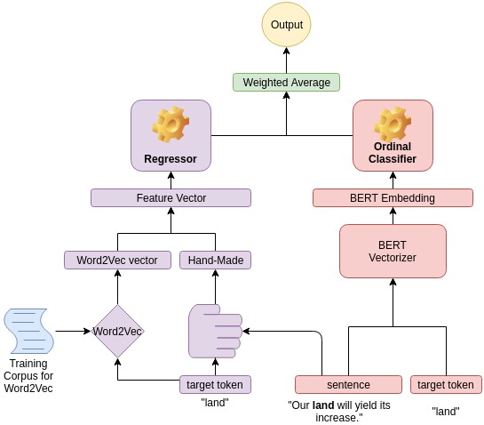
The Dual Model Architecture

Slide 10
Experiments
BERT-based contextual model
Tree-based non-contextual model
Feature Selection and hyperparameter tuning

Slide 11
Model | Feature Vector Description | Pearson Corr. Coeff on Multi Trial Data | Pearson Corr. Coeff on Single Trial Data
MLP Regressor | Only BERT-embedding (last 4 average) | 0.7011 | 0.6972
MLP Regressor | Only BERT-embedding (last 4 concat) | 0.7241 | 0.712
MLP Regressor | BERT-embedding + Hand-crafted features | 0.7389 | 0.737
MLP Classifier | BERT-embedding + Hand-crafted features | 0.6412 | 0.6714
MLP Ordinal Classifier | BERT-embedding + Hand-crafted features | 0.7454 | 0.7433
XGBoost Regressor | Hand-crafted features | - | 0.7132
AdaBoost Regressor | Hand-crafted features | - | 0.6935

Slide 12
Model | Feature Vector Description | Pearson Corr. Coeff on Multi Trial Data | Pearson Corr. Coeff on Single Trial Data
GradientBoosting Regressor | Hand-crafted features | - | 0.7436
XGBoost Regressor | Word2Vec + Hand-crafted features | 0.7419 | 0.7275
AdaBoost Regressor | Word2Vec + Hand-crafted features | 0.7174 | 0.6985
GradientBoosting Regressor | Word2Vec + Hand-crafted features | 0.7501 | 0.7678
Stacking Regressor (XGBoost, AdaBoost, GradientBoosting) | Word2Vec + Hand-crafted features | 0.7587 | 0.756
Ensemble of Stacking Regressor and MLP-Ordinal Classifier | BERT-Embedding + Word2Vec + Hand-crafted features | 0.7867 | 0.7603
Ensemble of GradientBoosting Regressor and MLP-Ordinal Classifier | BERT-Embedding + Word2Vec + Hand-crafted features | 0.7524 | 0.796

Slide 13
Results and Discussions
From the pearson’s correlation scores, we infer that:
Inclusion of hand-crafted feature vector improves the score as compared to only Bert-Embeddings.
Including Word2Vec with the hand-crafted feature vector increases the score.
For the single-word prediction task, Gradient Boosting Regressor worked better than others.
For the multi-word prediction task, Stacking Regressor combining XGBoost, AdaBoost and Gradient Boosting seemed to perform better.
The best overall performance was found using a weighted ensemble of the contextual and non-contextual model outputs.
These results clearly show that both contextual and non-contextual features are strong contingents in determining the complexity of a word/phrase.

Slide 14

Thank You :)

